Slide 1
Hurricane IDA (2021)
Wind Team @ EMC

Slide 2
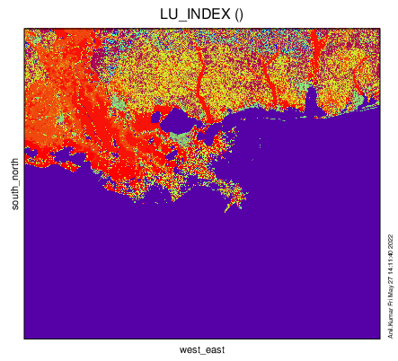
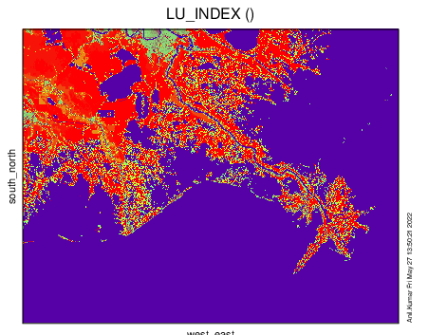
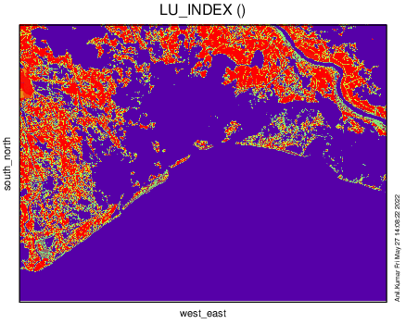
Domain Configuration
Domain 1 = 1098 x 958 grid points (500 m)
Domain 2 = 1049 x 820 grid points (166 m)
Domain 3 = 1303 x 985 grid points (50 m)
Domain 1 – 1800 UTC 28 Aug to 1800 UTC 30 Aug 2021 ( 48 hours and Hourly Outputs)
Domain 2 – 0600 UTC 29 Aug to 0600 UTC 30 Aug 2021 ( 24 hours and 6-mins Outputs)
Domain 3 – 0600 UTC 29 Aug to 0600 UTC 30 Aug 2021 ( 24 hours and 6-mins Outputs)
SIMULATION TIME

Slide 3
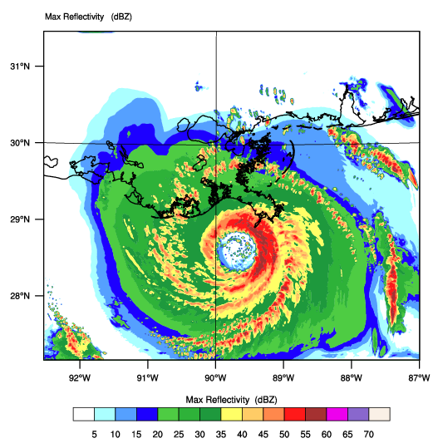
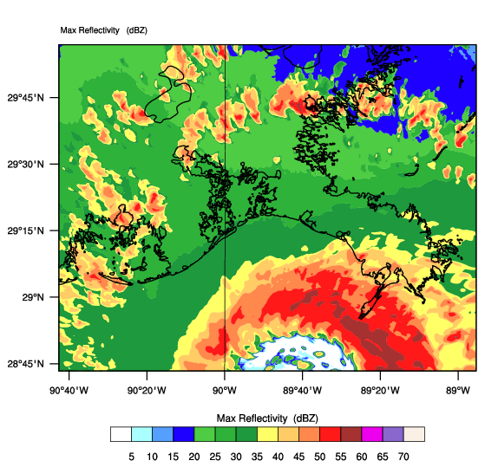
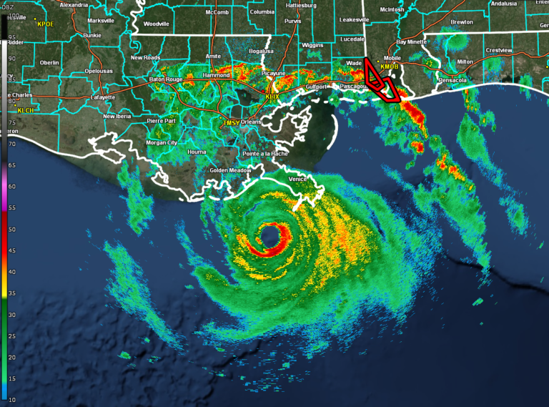
RADAR & MODEL REFLECTIVITY
1300 UTC 29 AUG 2021
Radar - Model Domain1
Radar Obs
Radar - Model Domain2

Slide 4
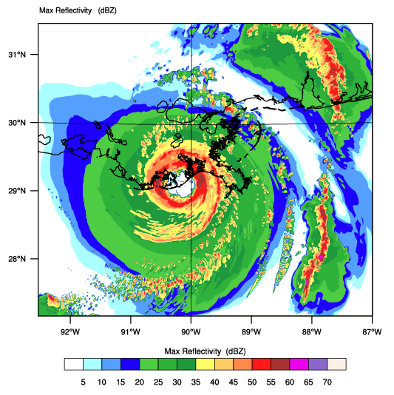
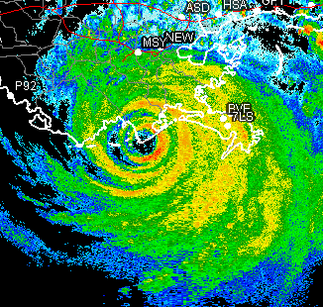
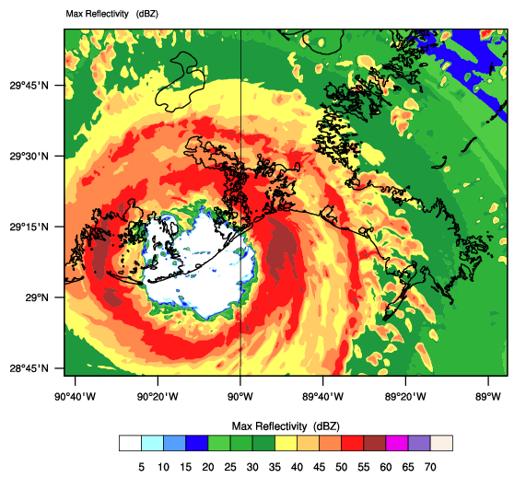
RADAR & MODEL REFLECTIVITY
1700 UTC 29 AUG 2021
Radar - Model Domain1
Radar Obs
Radar - Model Domain2

Slide 5
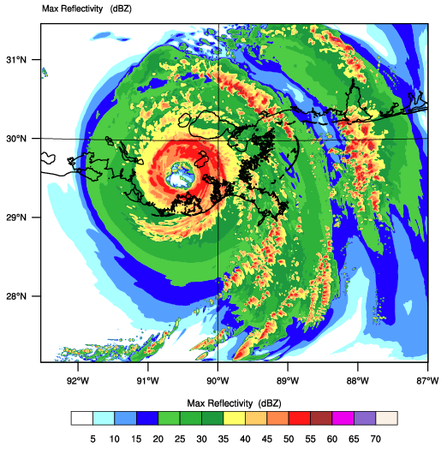
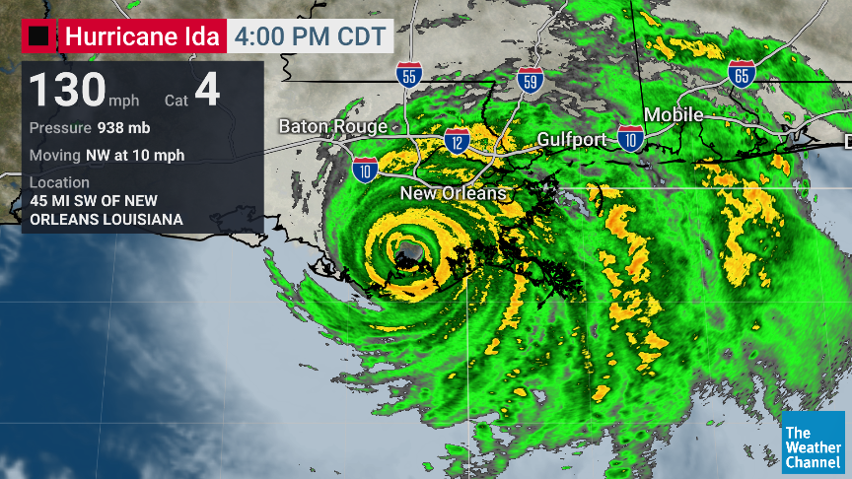
RADAR & MODEL REFLECTIVITY
2100 UTC 29 AUG 2021
Radar - Model Domain1
Radar Obs

Slide 6
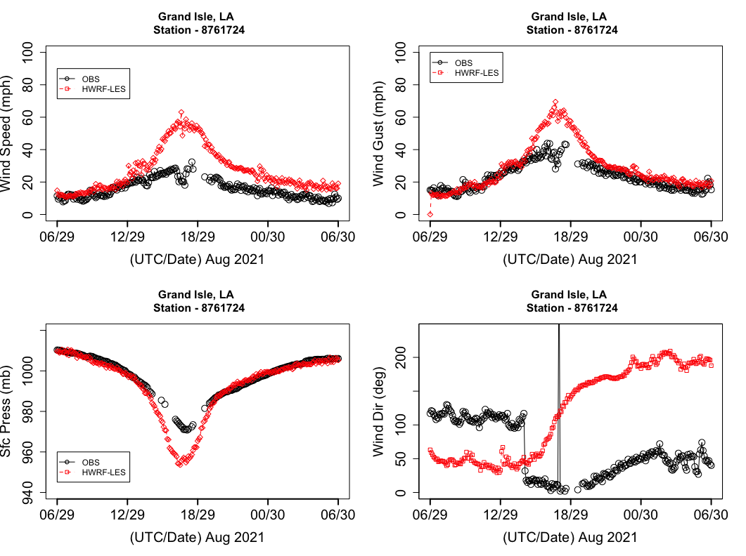
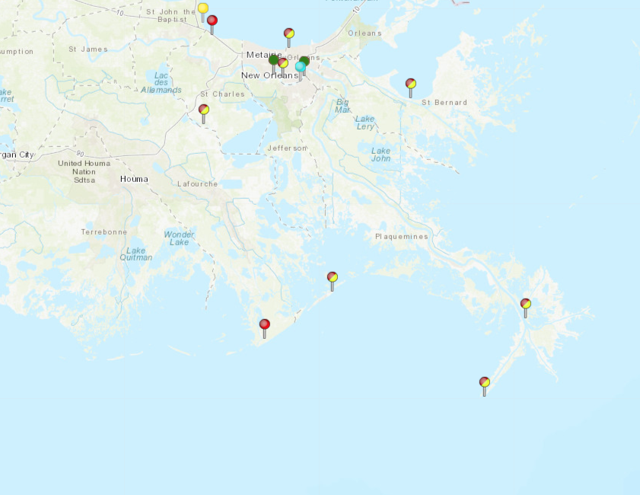
Station - Grand Isle

Slide 7
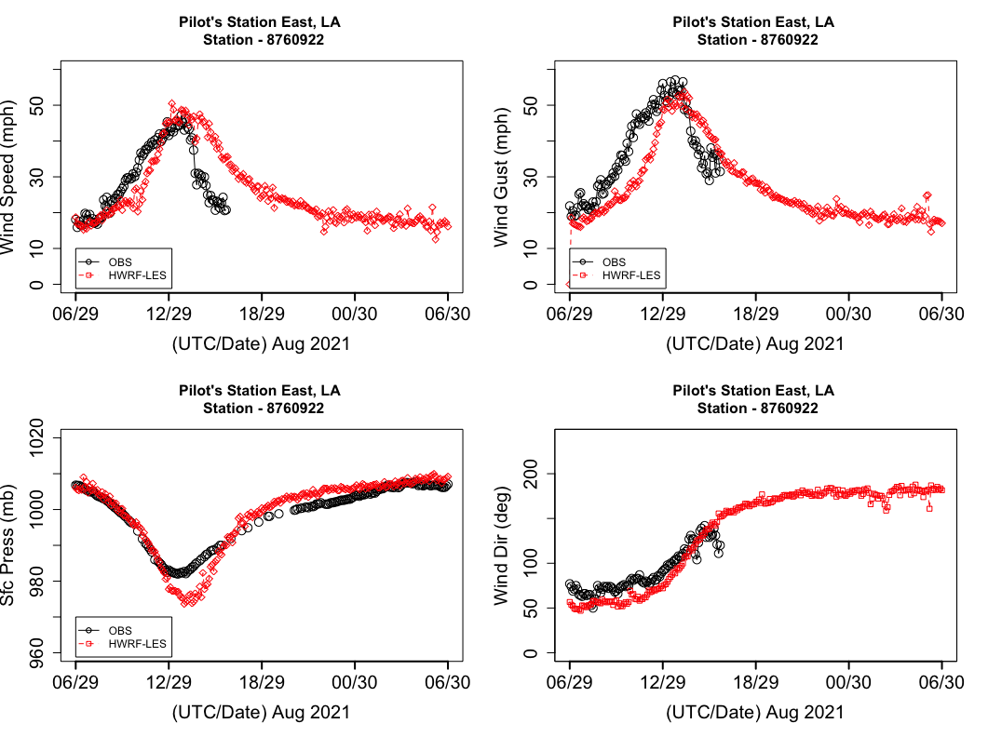
Station – Pilot Town East

Slide 8
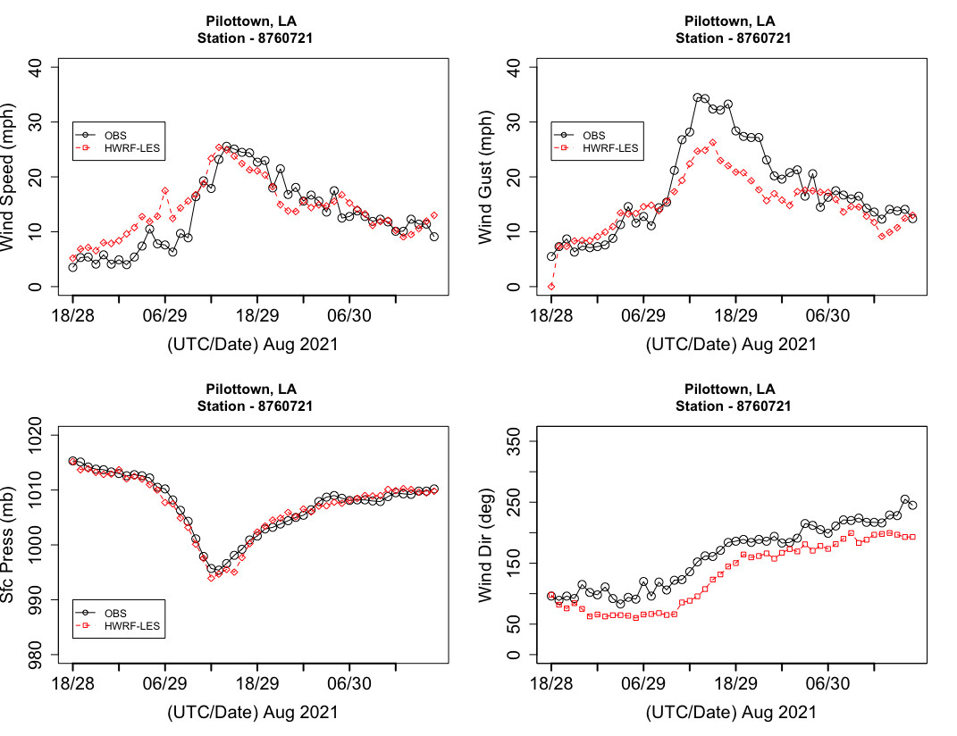
Station – Pilot Town

Slide 9
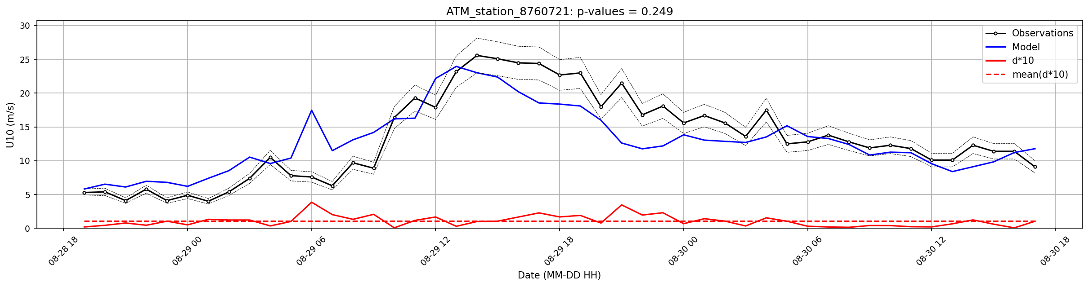
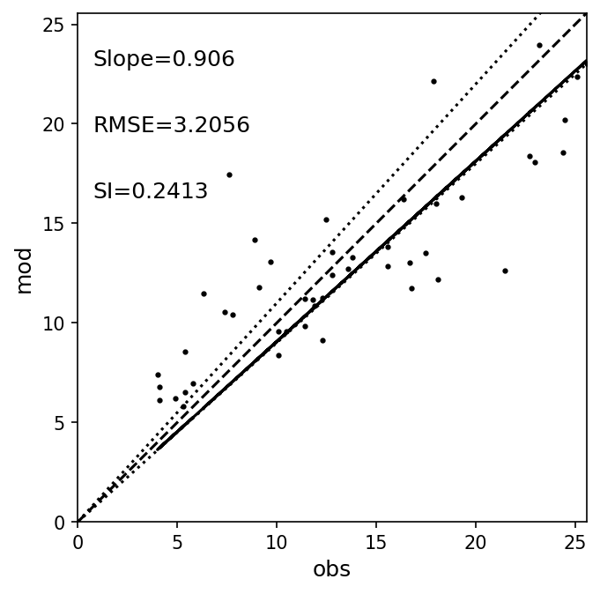
Station – Pilot Town

Slide 10
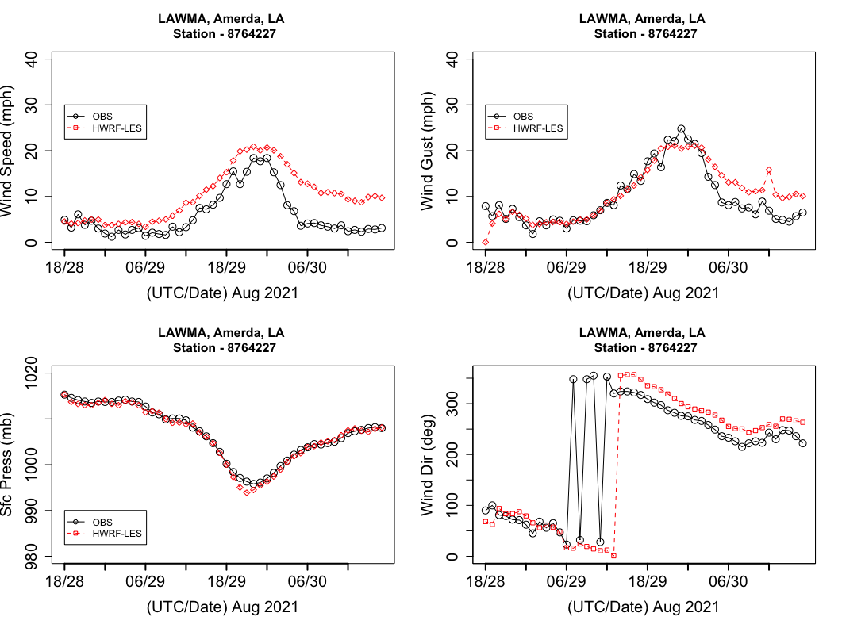
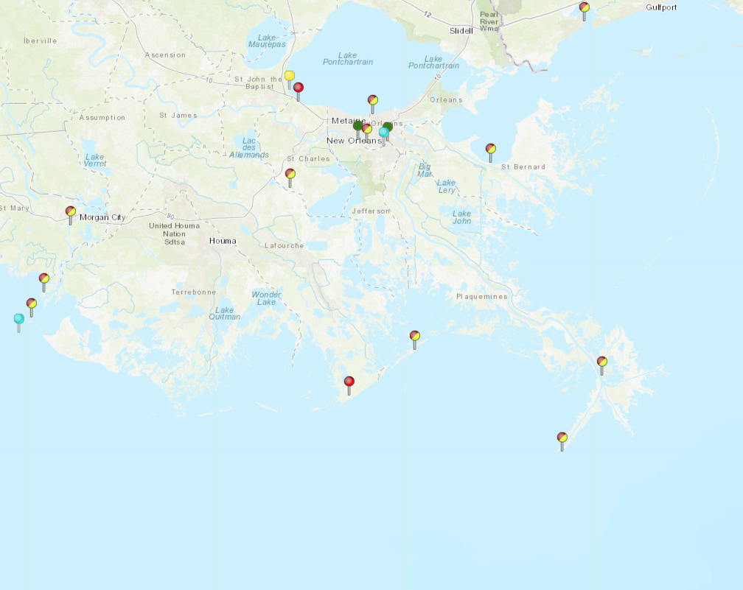
Station – LAWMA, Amerada Pass, LA

Slide 11
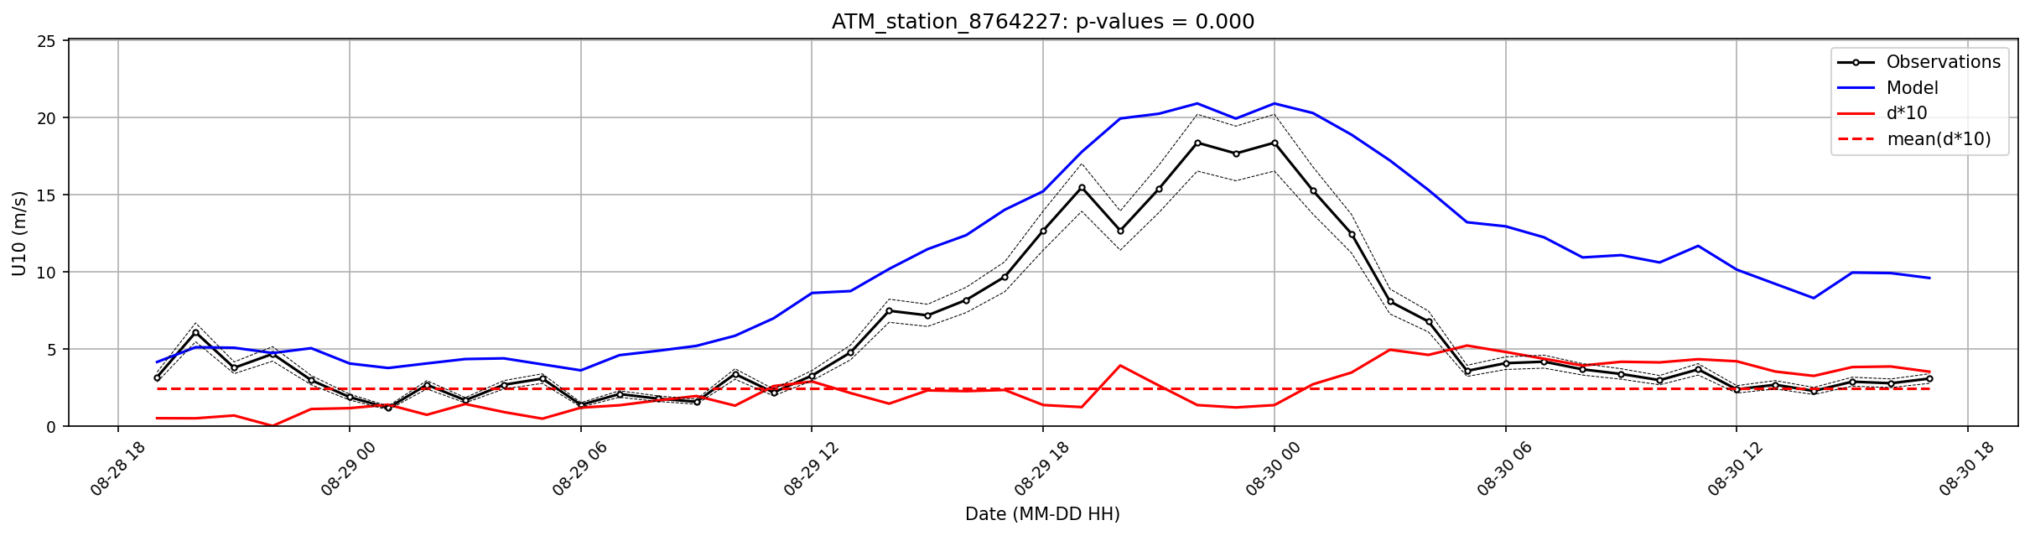
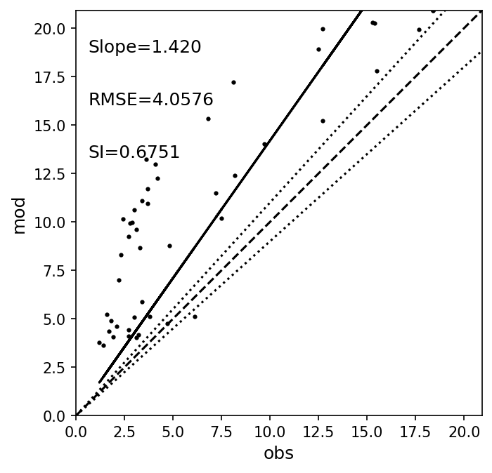

Slide 12
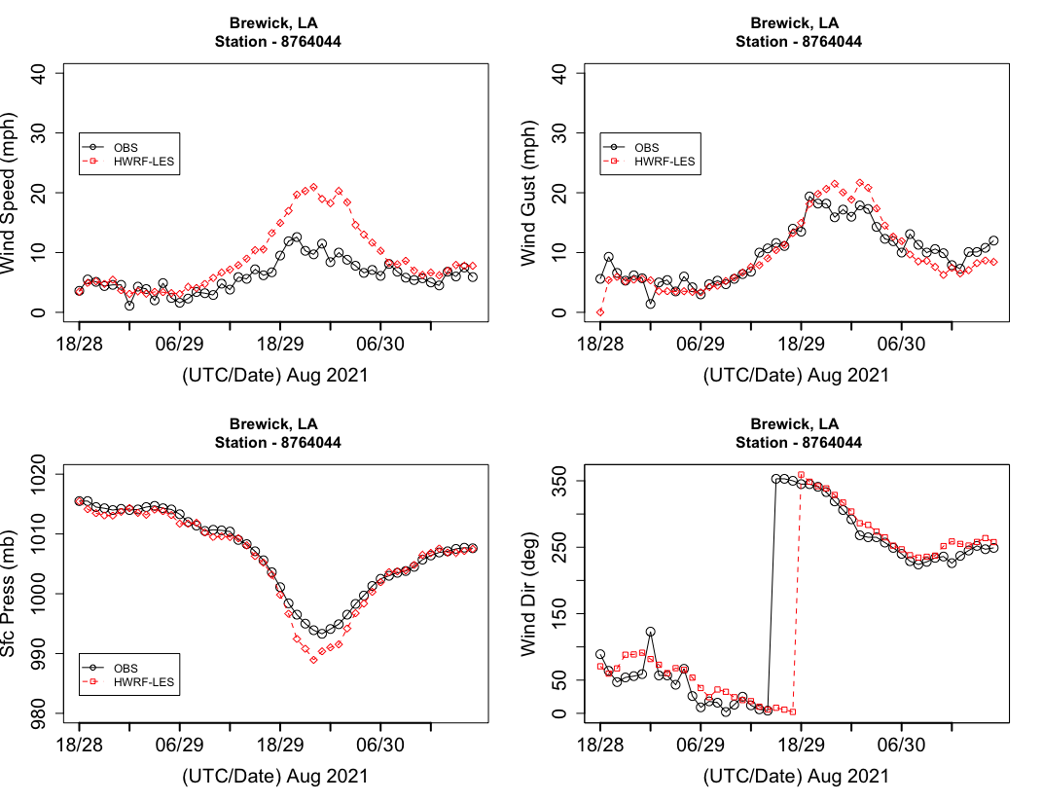
Station Berwick, Atchafalaya River, LA

Slide 13
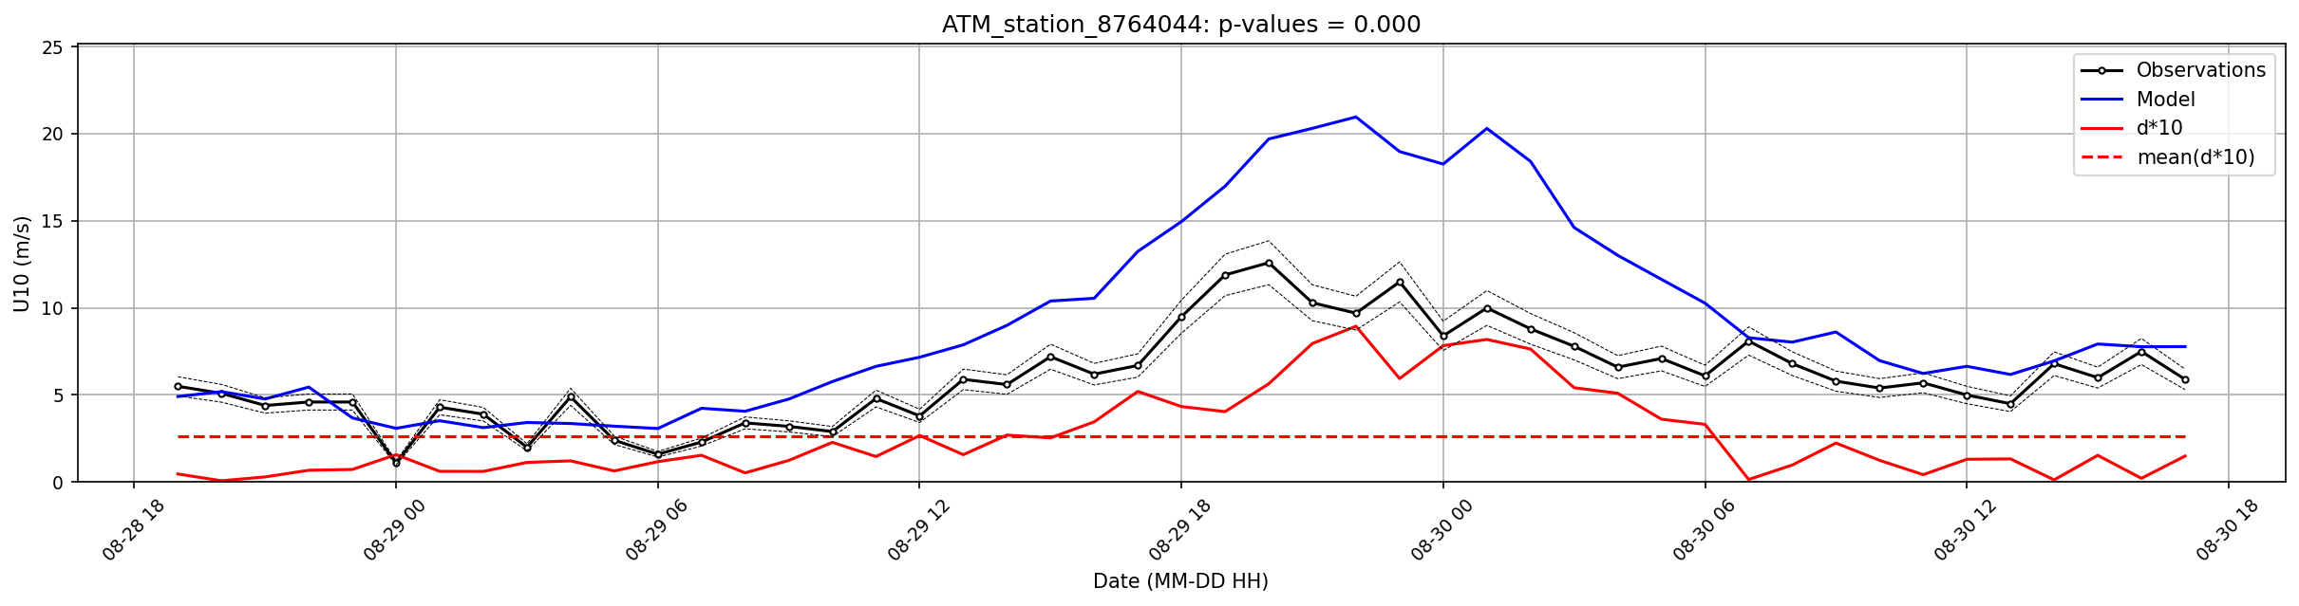
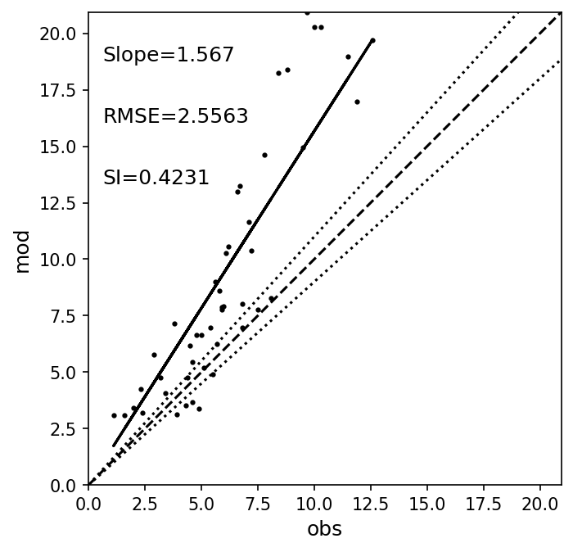

Slide 14
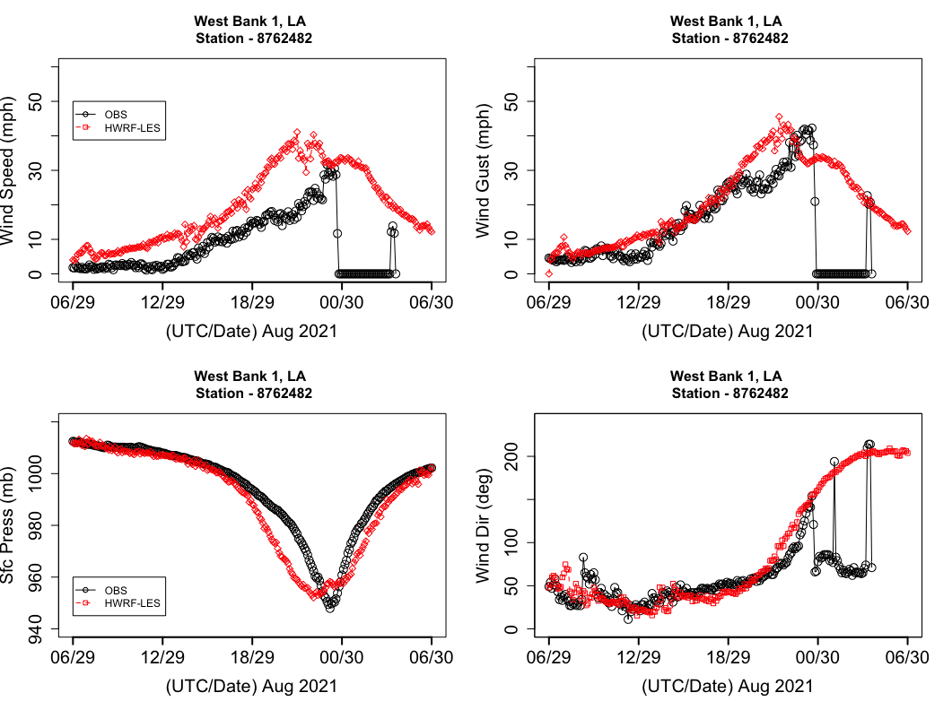
Station - West Bank 1, Bayou Gauche, LA

Slide 15
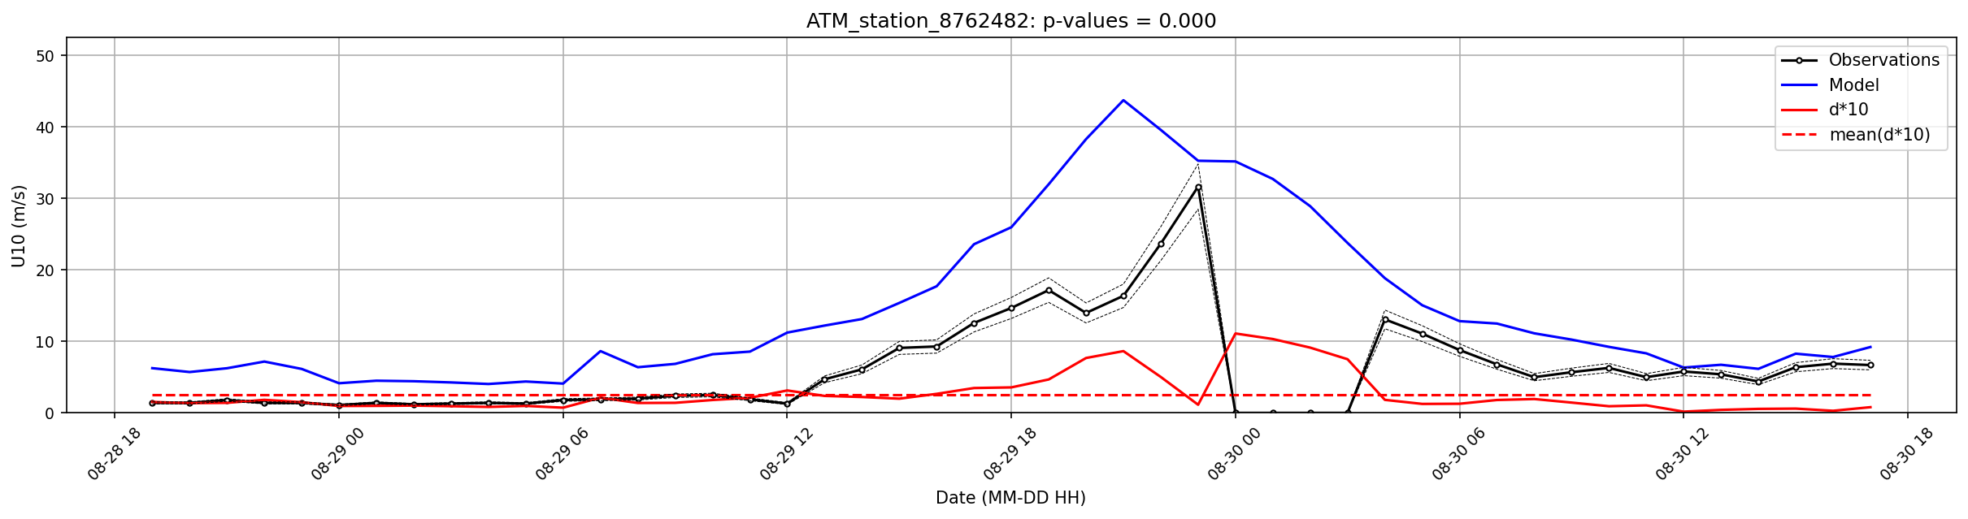
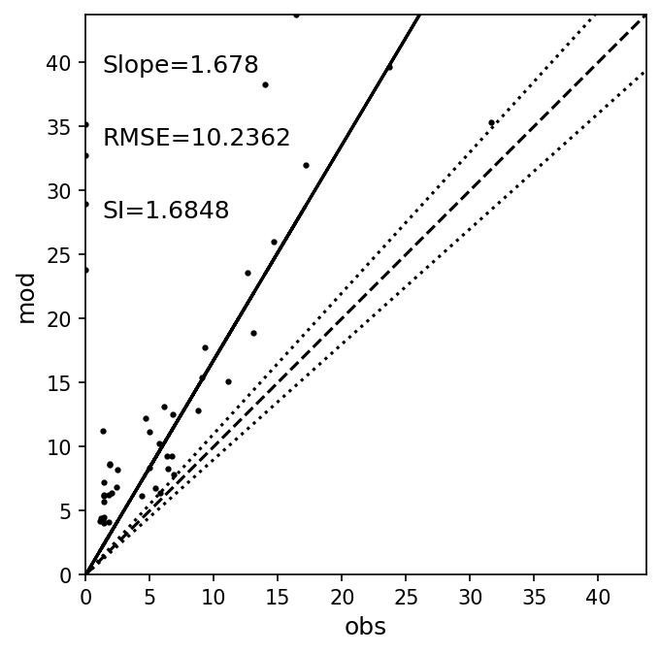

Slide 16
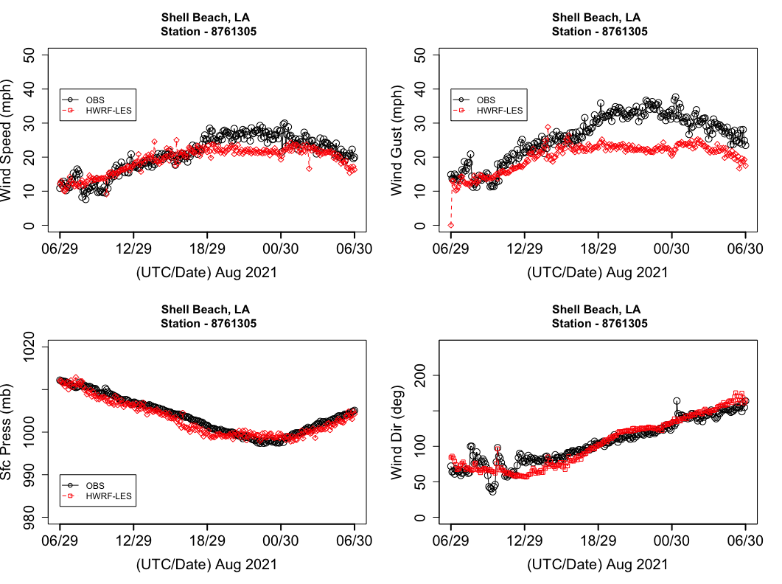
Station - Shell Beach, LA

Slide 17
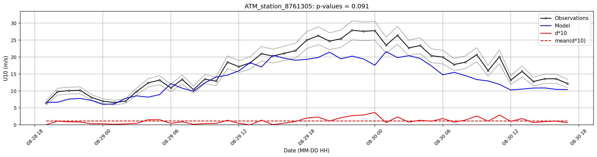
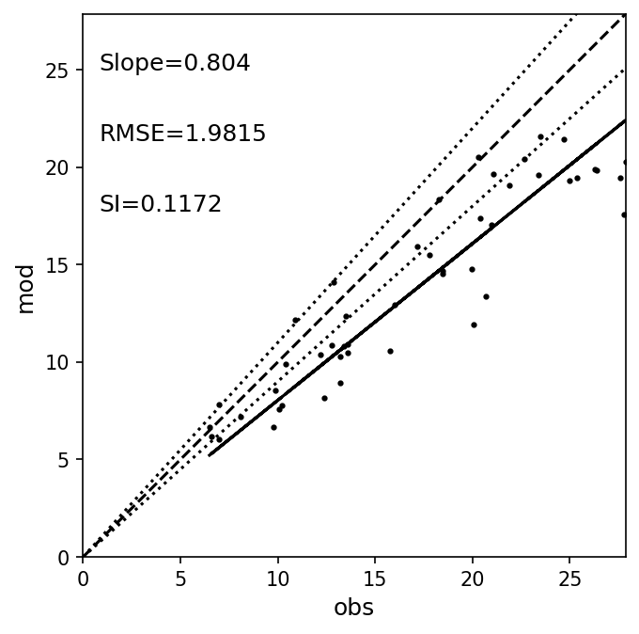

Slide 18
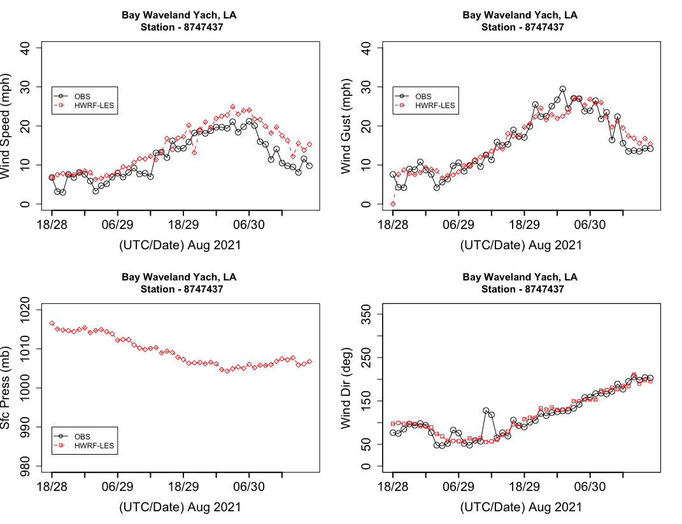
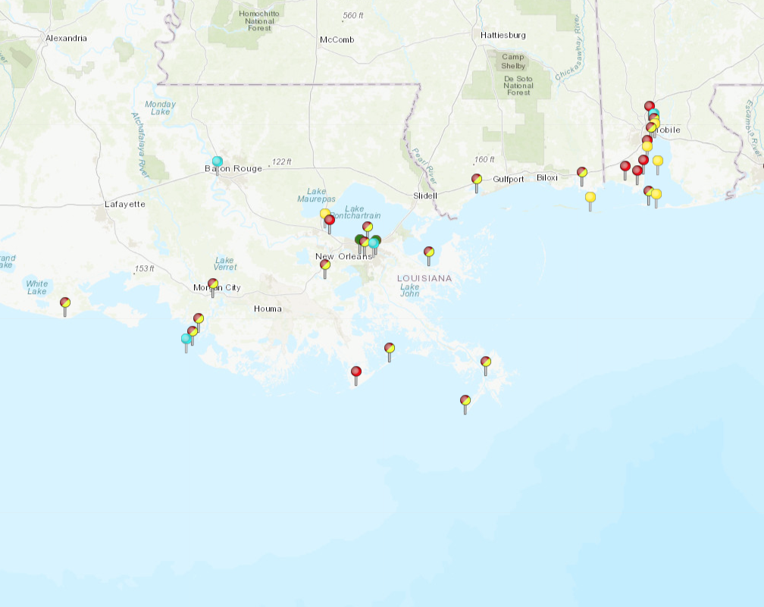
Station - Bay Waveland Yacht Club, MS

Slide 19
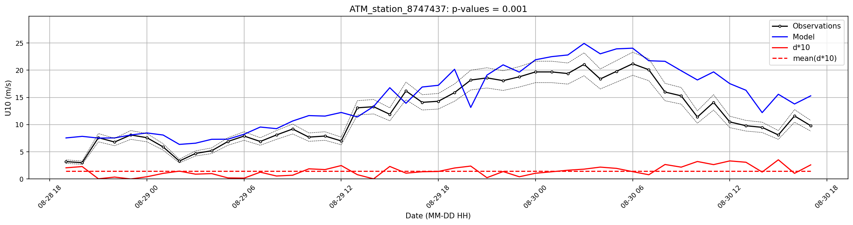
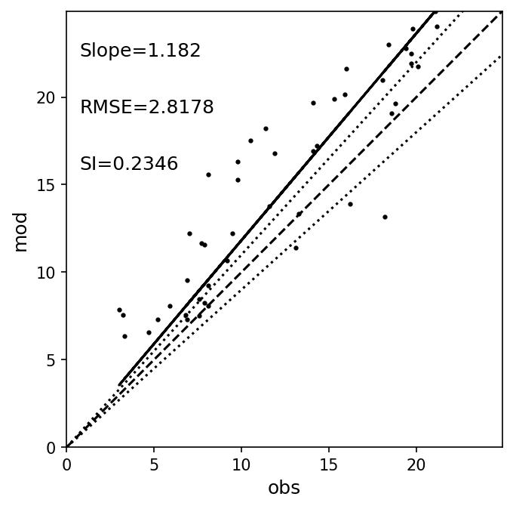

Slide 20
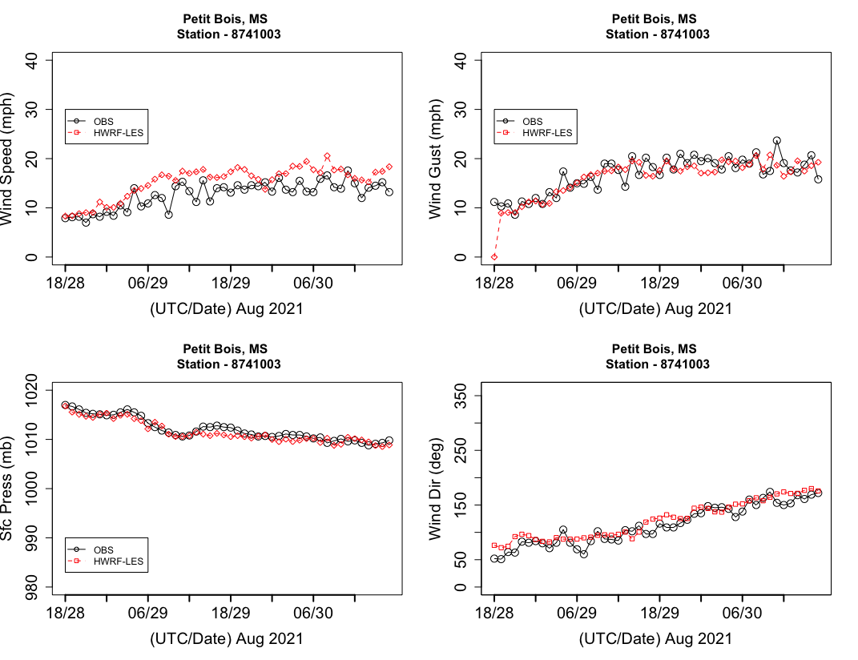
Station - Petit Bois Island, Port of Pascagoula, MS

